Slide 1

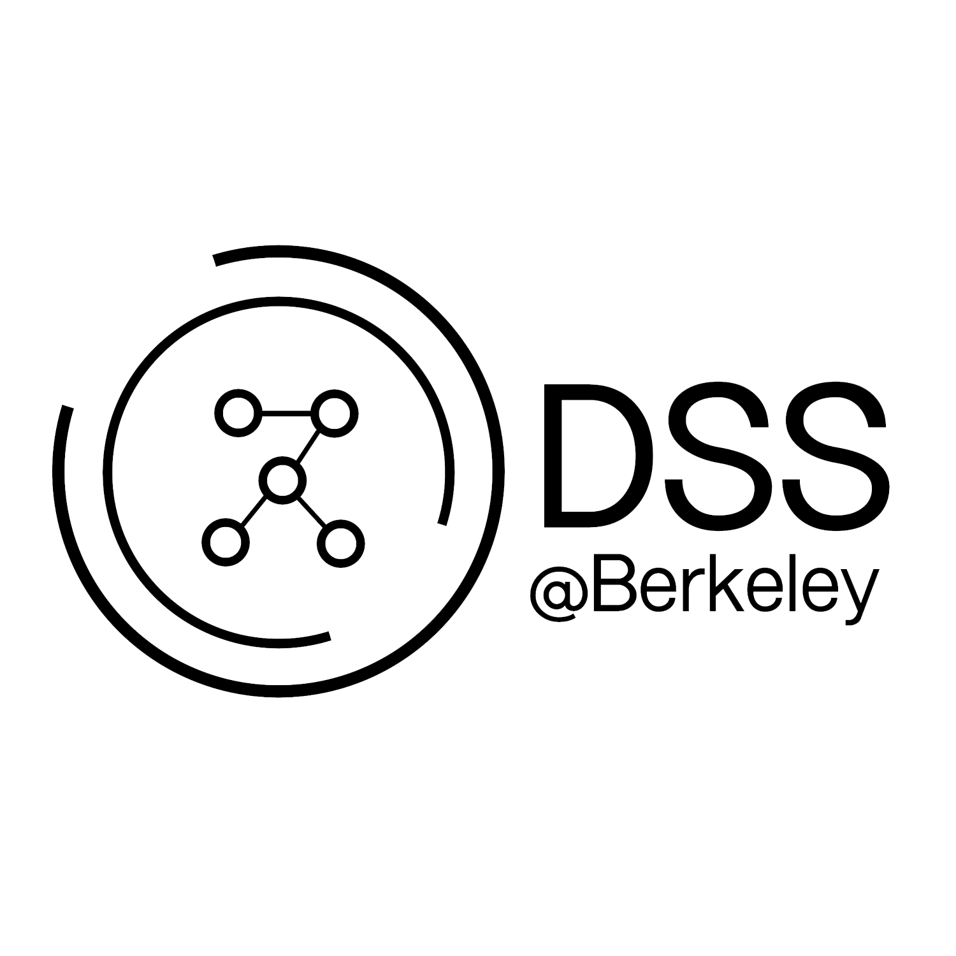
Python Libraries
and Visualizations
https://tinyurl.com/pythondss

Slide 2


About us!
Marissa Pagador
Sophomore
Data Science
Zoe Parcells
Sophomore
Applied Mathematics
Spring 2018

Slide 3


Teaching Assistants
Anjali Unnithan
Junior
Statistics
Kevin Woo
Sophomore
Data Science/Economics
Spring 2018

Slide 4
About DSS!
Founded in early 2016, Data Science Society is UC Berkeley’s first and only undergraduate student organization focused on Data Science.
DSS is committed to helping students build their Data Science skills through learning opportunities and cultivating an academic environment by connecting students with industry leaders and researchers.
Check out our website! https://dss.berkeley.edu/
Follow us on Facebook to stay updated about future workshops and events:
https://www.facebook.com/dssberkeley/
Spring 2018

Slide 5
Ice Breaker
name | major | year | fun memory | favorite animal | last movie watched
Spring 2018

Slide 6
Python Libraries Overview
What is a Python library?
a library is a collection of functions and methods that allows you to perform lots of actions without writing your own code
each library in Python contains a huge number of useful modules that you can import for your everyday programming
Spring 2018

Slide 7
Python Libraries Overview
Numpy
arrays, matrices, math operations
Pandas
dataframes, series
Matplotlib
creating plots, visualizations
Seaborn
more visually appealing plots, statistical graphics
Spring 2018
Notes:
All used in data science for manipulating data and making visualizations

Slide 8
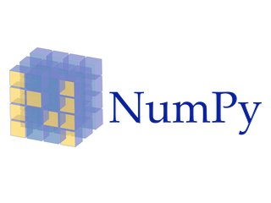
Numpy: Why?
Numpy arrays are grids of values of the same type
Numpy arrays are more compact than Python lists
take less space, faster and more efficient
Extra operations
avoid unnecessary work and human error
Spring 2018

Slide 9
Numpy Demo Preparation
Arithmetic
adding values and arrays
Conditionals
Array functions
sum, minimum/maximum, median, etc.
[DEMO - https://tinyurl.com/pythondss]
Spring 2018
Notes:
Karen

Slide 10
Condensed Python Reference for Demo
np.sum(x) | Returns the sum of the values in an array
np.min(x) and np.max(x) | Returns the minimum value of an array and Returns the maximum value of an array
np.average(x) | Returns the mean value of an array
np.abs(x) | Take the absolute value of number or each number in an array.
np.diff(x) | Returns a new array of size len(arr)-1 with elements equal to the difference between adjacent elements; val_2 - val_1, val_3 - val_2, etc.
np.arange(start, stop, step) | An array of numbers starting with start, going up in increments of step, and going up to but excluding stop. When start and/or step are left out, default values are used in their place. Default step is 1; default start is 0.
np.append(x) | Returns a copy of the input array with item (must be the same type as the other entries in the array) appended to the end.
Spring 2018

Slide 11

Post Demo Discussion
What concepts are still difficult?
What is a situation in which you think using numpy would be helpful?
Is there anything you are working on right now that you could use numpy for?
Spring 2018

Slide 12
Numpy Resources
Data 8 Websites!
Lectures from Fall 2018 and Spring 2019
Python Reference
Google ‘s Python Class (Free!) for Beginners
Related University Forum for questions and discussion
Spring 2018

Slide 13

PANDAS: Why?
Works better for larger datasets
Can take in different types of data
versus numpy requires same
R-style syntax
helpful if you are switching between R and Python
Spring 2018
Notes:
Karen

Slide 14
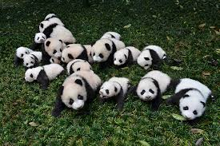

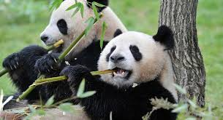
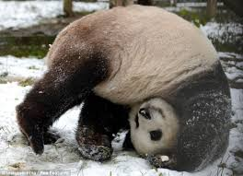
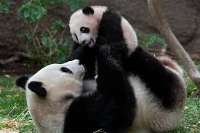
Spring 2018

Slide 15

How I feel learning PANDAS...
Spring 2018

Slide 16
PANDAS Demo Preparation
Tables
Making tables, naming columns of tables, extracting columns
Cleaning Data
Selecting rows, columns, applying conditions
Applying Numpy to PANDAS
[DEMO - https://tinyurl.com/pythondss]
Spring 2018

Slide 17

Post Demo Discussion
What concepts are still difficult?
What are some significant differences between Numpy and PANDAS?
What is a situation in which you think using PANDAS would be helpful?
Is there anything you are working on right now that you could use PANDAS for?
Spring 2018

Slide 18
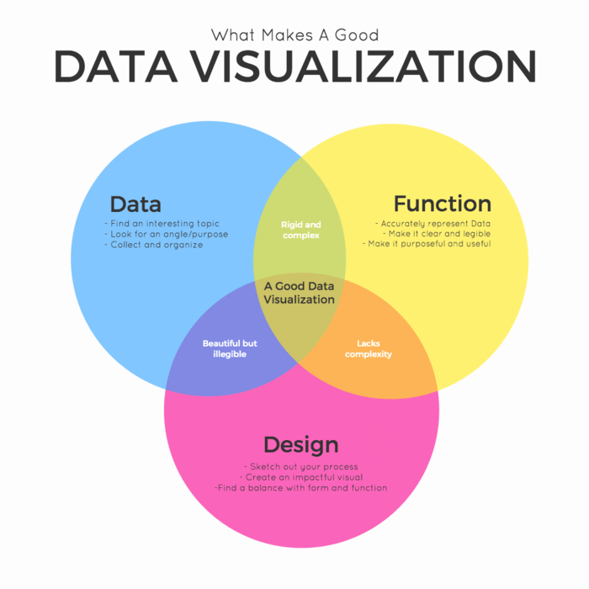
Visualizations
Visualizations are essential to data analysis
It involves communicating your findings effectively through graphical means
It might include graphs, charts, mind maps, infographics, and other visuals to help convey key data findings and insights.
Spring 2018

Slide 19
Visualizations
Spring 2018
Notes:
intersection of data, design, function

Slide 20
Visualizations
What we will cover:
graphing with pandas
graphing with matplotlib
graphing with seaborn
Spring 2018

Slide 21
Some Questions for You - Discuss
Why would we want to create graphs of our data?
What can we learn from visualizations, that we can’t easily see just from looking at data in data frames and tables?
Spring 2018
Notes:
Graphs allow us to visualize distributions of data, give us a way to present information that can be too large to describe in words alone
We can see the relationships between different variables, see correlations, see patterns and trends, understand data better

Slide 22
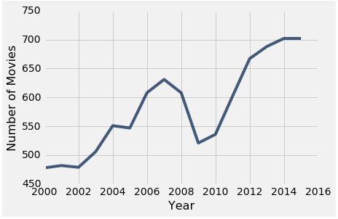
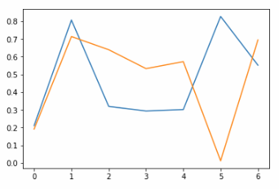
Line Graphs
First we’ll look at Line Graphs:
line graphs are generally used to show change over time
a single line represents one set of data
multiple lines can be used to represent multiple sets of data over the same x and y variables
Spring 2018

Slide 23
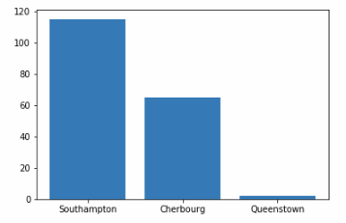
Bar Graphs
Now let’s look at bar graphs:
bar graphs are used to show a distribution of categorical data
one axis is categorical, one is numerical
one bar corresponds to each category
the height (or length) of the bar is the count of individuals in that category
Spring 2018
Notes:
Karen

Slide 24
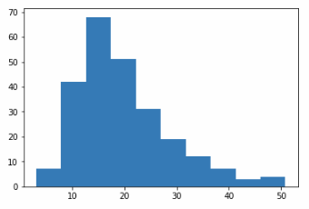
Histograms
Next let’s look at histograms:
histograms are used to show a distribution of numerical data
shows the frequency of one continuous variable across a range separated into “bins”
one bar corresponds to each bin
uses the area principle
the area of each bar (base x height) is the percent of individual points in that bin
Spring 2018

Slide 25
Bar Graph vs Histogram
Bar Graph:
distribution of categorical variable
bars have arbitrary (but equal) widths and spacings
height (or length) of bars proportional to the percent of individuals
Histogram:
distribution of numerical variable
horizontal axis is numerical: to scale, no gaps, bins can be unequal
Area of bars proportional to the percent of individuals
Spring 2018
Notes:
Karen

Slide 26
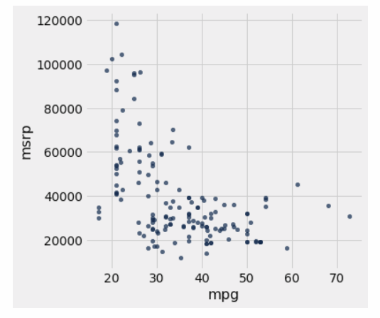
Scatterplots
Lastly, we’ll talk about scatterplots:
scatterplots use dots on a coordinate plane to represent two variables of data
show the relationship between the two variables, which is their correlation
color coding of points can be used to represent groups or categories that points belong to
Spring 2018

Slide 27
Questions - Discuss
Which type of graph would you use in each situation? Why?
A survey of favorite ice cream flavors had these results: 15 for vanilla, 18 for strawberry, 20 for chocolate, and 7 for mint chip.
A child’s height is measured each year from 2005 to 2019
In a bucket of 100 fish, the fish’s individual weights vary from 6 ounces to 10 ounces
You’re sorting the books in your house by genre and want to know which genre you have the most books about
You have receipts from all the orders at your restaurant today, and want to know if tips increase or decrease as the total bill increases
Spring 2018

Slide 28
Questions - Answers
Which type of graph would you use in each situation? Why?
A survey of favorite ice cream flavors had these results: 15 for vanilla, 18 for strawberry, 20 for chocolate, and 7 for mint chip - Bar Graph
A child’s height is measured each year from 2005 to 2019 - Line Graph
In a bucket of 100 fish, the fish’s individual weights vary from 6 ounces to 10 ounces - Histogram
You’re sorting the books in your house by genre and want to know which genre you have the most books about - Bar Graph
You have receipts from all the orders at your restaurant today, and want to know if tips increase or decrease as the total bill increases - Scatter Plot
Spring 2018
Notes:
categorical vs count
numerical over time
range of values - bins and frequency
categorical vs count
two numerical values, looking for correlation

Slide 29

Matplotlib
Matplotlib is a plotting library for Python and NumPy
It provides an object-oriented API for embedding plots into applications using general-purpose graphical user interface toolkits like Tkinter, wxPython, Qt, or GTK+
many different kinds of graphs can be made using matplotlib!
see documentation to explore more
Spring 2018

Slide 30
Matplotlib
Let’s delve into the matplotlib functions for graphing!
plt.plot()
plt.bar() and plt.barh()
plt.hist()
plt.scatter()
Spring 2018

Slide 31
Demo
DEMO
[https://tinyurl.com/pythondss]
Spring 2018

Slide 32
Post Demo Discussion
Any questions?
Which graphing/matplotlib concept was difficult? What can be clarified?
Spring 2018

Slide 33

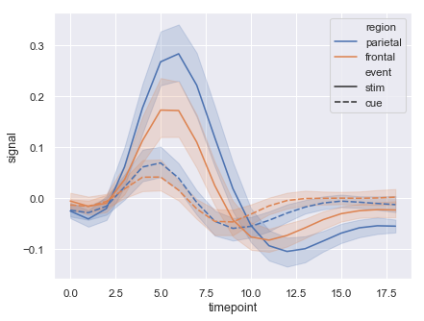
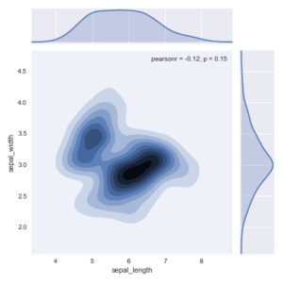
Seaborn
Seaborn is a Python data visualization library based on matplotlib
It provides a high-level interface for drawing attractive and informative statistical graphics
used for prettier aesthetics and sometimes simpler syntax
good for complex graphs and analysis
Spring 2018
Notes:
lineplot with error bands
2D contour with marginal plots - jointplot() function
many graph functions are more complicated than what we are covering here, so see the documentation or take data 100 to learn more!

Slide 34
Seaborn
Seaborn functions for graphing that we will be looking at:
sns.distplot()
sns.lmplot()
Spring 2018
Notes:
Shalini

Slide 35
Seaborn
DEMO
[https://tinyurl.com/pythondss]
Spring 2018
Notes:
Shalini

Slide 36
Review [1/3]
Arithmetic
adding values and arrays
Conditionals
Array functions
sum, minimum/maximum, etc.
Spring 2018

Slide 37
Review [2/3]
Tables
Making tables, naming columns of tables, extracting columns
Cleaning Data
Selecting rows, columns, applying conditions
Applying Numpy to PANDAS
Spring 2018

Slide 38
Review [3/4]
Visualizations
Types of graphs
line graphs
bar graphs
histograms
scatterplots
Matplotlib library
Seaborn library
Spring 2018
Notes:
why do we create visualizations of data instead of just looking at tables and pandas dataframes?
what are the differences between bar graphs and histograms?
what’s the difference between matplotlib and seaborn?

Slide 39
Review [4/4]
Questions?
Comments?
Concerns?
Spring 2018

Slide 40
Mini Project - Discuss:
A local restaurant reaches out to you, impressed by your skills in manipulating data. The owner there wants to find some sort of correlation between different days of the week and the total amount of money made on each day.
What steps can you take to begin addressing their needs? How would you find which day(s) seem to be the most profitable?
Spring 2018

Slide 41
Thanks!
Thank you for coming out to our first Academic Development workshop!
https://www.facebook.com/dssberkeley
Follow us on facebook to keep updated about future events and workshops!
Spring 2018

Slide 42
Feedback
Give us feedback at
https://goo.gl/forms/tx23Ug303lMWTIzE3

